Slide 1
Lecture 1:
Binary and Binomial Heaps
These lecture slides are adapted
from CLRS, Chapters 6, 19.

Slide 2
Priority Queues
Supports the following operations.
  Insert element x.
  Return min element.
  Return and delete minimum element.
  Decrease key of element x to k.
Applications.
  Dijkstra's shortest path algorithm.
  Prim's MST algorithm.
  Event-driven simulation.
  Huffman encoding.
  Heapsort.
  . . .
Notes:
Event driven simulation: generate random inter-arrival times between customers, generate random processing times per customer, Advance clock to next event, skipping intervening ticks

Slide 3
Priority Queues in Action
PQinit()
for each v ∈ V
key(v) ← ∞
PQinsert(v)
key(s) ← 0
while (!PQisempty())
v = PQdelmin()
for each w ∈ Q s.t (v,w) ∈ E
if π(w) > π(v) + c(v,w)
PQdecrease(w, π(v) + c(v,w))
Dijkstra's Shortest Path Algorithm

Slide 4
Priority Queues
Heaps
Operation
Linked List
Binary
Binomial
Fibonacci *
make-heap
1
1
1
1
insert
1
log N
log N
1
find-min
N
1
log N
1
delete-min
N
log N
log N
log N
union
1
N
log N
1
decrease-key
1
log N
log N
1
delete
N
log N
log N
log N
is-empty
1
1
1
1
Notes:
not possible to get all ops O(1) if only use comparisons because of N log N sorting lower bound
Brodal gives variant of relaxed heap that achieves worst-case bounds for all operations
relaxed heap: relaxes heap ordering property

Slide 5
Binary Heap: Definition
Binary heap.
  Almost complete binary tree.
    filled on all levels, except last, where filled from left to right
  Min-heap ordered.
    every child greater than (or equal to) parent
06
14
45
78
18
47
53
83
91
81
77
84
99
64

Slide 6
Binary Heap: Properties
Properties.
  Min element is in root.
  Heap with N elements has height = ⎣log₂ N⎦.
06
N = 14
Height = 3
14
45
78
18
47
53
83
91
81
77
84
99
64

Slide 7
Binary Heaps: Array Implementation
Implementing binary heaps.
  Use an array: no need for explicit parent or child pointers.
    Parent(i) = ⎣i/2⎦
    Left(i) = 2i
    Right(i) = 2i + 1
06
1
14
45
2
3
78
18
47
53
4
5
6
7
83
91
81
77
84
99
64
8
9
10
11
12
13
14
Notes:
parent and children formula require only simple bit twiddling operations

Slide 8
Binary Heap: Insertion
Insert element x into heap.
  Insert into next available slot.
  Bubble up until it's heap ordered.
    Peter principle: nodes rise to level of incompetence
06
14
45
78
18
47
53
83
91
81
77
84
99
64
42
next free slot

Slide 9
Binary Heap: Insertion
Insert element x into heap.
  Insert into next available slot.
  Bubble up until it's heap ordered.
    Peter principle: nodes rise to level of incompetence
swap with parent
06
14
45
78
18
47
53
83
91
81
77
84
99
64
42
42

Slide 10
Binary Heap: Insertion
Insert element x into heap.
  Insert into next available slot.
  Bubble up until it's heap ordered.
    Peter principle: nodes rise to level of incompetence
swap with parent
06
14
45
78
18
47
42
83
91
81
77
84
99
64
42
53

Slide 11
Binary Heap: Insertion
Insert element x into heap.
  Insert into next available slot.
  Bubble up until it's heap ordered.
    Peter principle: nodes rise to level of incompetence
  O(log N) operations.
stop: heap ordered
06
14
42
78
18
47
45
83
91
81
77
84
99
64
53

Slide 12
Binary Heap: Decrease Key
Decrease key of element x to k.
  Bubble up until it's heap ordered.
  O(log N) operations.
06
14
42
78
18
47
45
83
91
81
77
84
99
64
53

Slide 13
Binary Heap: Delete Min
Delete minimum element from heap.
  Exchange root with rightmost leaf.
  Bubble root down until it's heap ordered.
    power struggle principle: better subordinate is promoted
06
14
42
78
18
47
45
83
91
81
77
84
99
64
53

Slide 14
Binary Heap: Delete Min
Delete minimum element from heap.
  Exchange root with rightmost leaf.
  Bubble root down until it's heap ordered.
    power struggle principle: better subordinate is promoted
53
14
42
78
18
47
45
83
91
81
77
84
99
64
06

Slide 15
Binary Heap: Delete Min
Delete minimum element from heap.
  Exchange root with rightmost leaf.
  Bubble root down until it's heap ordered.
    power struggle principle: better subordinate is promoted
exchange with left child
53
14
42
78
18
47
45
83
91
81
77
84
99
64

Slide 16
Binary Heap: Delete Min
Delete minimum element from heap.
  Exchange root with rightmost leaf.
  Bubble root down until it's heap ordered.
    power struggle principle: better subordinate is promoted
exchange with right child
14
53
42
78
18
47
45
83
91
81
77
84
99
64

Slide 17
Binary Heap: Delete Min
Delete minimum element from heap.
  Exchange root with rightmost leaf.
  Bubble root down until it's heap ordered.
  O(log N) operations.
stop: heap ordered
14
18
42
78
53
47
45
83
91
81
77
84
99
64

Slide 18
Binary Heap: Heapsort
Heapsort.
  Insert N items into binary heap.
  Perform N delete-min operations.
  O(N log N) sort.
  No extra storage.

Slide 19
Binary Heap: Union
Union.
  Combine two binary heaps H₁ and H₂ into a single heap.
  No easy solution.
    Ω(N) operations apparently required
  Can support fast union with fancier heaps.
H₁
H₂
14
11
78
18
53
62
41
91
81
77
84
99
64

Slide 20
Priority Queues
Heaps
Operation
Linked List
Binary
Binomial
Fibonacci *
make-heap
1
1
1
1
insert
1
log N
log N
1
find-min
N
1
log N
1
delete-min
N
log N
log N
log N
union
1
N
log N
1
decrease-key
1
log N
log N
1
delete
N
log N
log N
log N
is-empty
1
1
1
1

Slide 21
Binomial Tree
Def.: Binomial Tree. It is an Ordered Tree (children of a node are ordered) with the properties:
B₀ consists of a single node.
B_{k} consists of two binomial trees B_{k-1} that are linked together: the root of one is the leftmost child of the other.
B₀
B_{k}
  Recursive definition:
B_{k-1}
B_{k-1}
Notes:
not binary tree

Slide 22
Binomial Tree
A collection of binomial trees at most one of every rank.
Items at the nodes, heap ordered.
B₀
B₁
B₂
B₃
B₄
Notes:
not binary tree

Slide 23
Binomial Tree
Useful properties of order k binomial tree B_{k}.
  Number of nodes = 2^{k}.
  Height = k.
  Degree of root = k.
  Deleting root yields binomial
  trees B_{k-1}, … , B₀.
Proof.
  By induction on k.
B_{k+1}
B₁
B_{k}
B₂
B₀
B₀
B₁
B₂
B₃
B₄

Slide 24

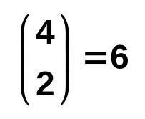
Binomial Tree
A property useful for naming the data structure.
  B_{k} has nodes at depth i.
depth 0
depth 1
depth 2
depth 3
depth 4
B₄

Slide 25
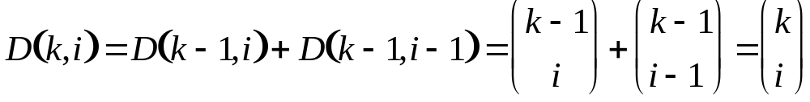
Properties of Binomial Tree
1. Since B_{k} consists of two copies of B_{k-1},
|B_{k}| = |B_{k-1}| + |B_{k-1}| = 2^{k-1} + 2^{k-1} = 2^{k}.
2. Because of the construction of B_{k} from two copies of B_{k-1}, the depth of B_{k} is one more than the depth of B_{k-1}.
3. Let D(k, i) be the number of nodes of B_{k} at depth i. Since B_{k} is made up of two copies of B_{k-1}, linked in a special way, D(k, i) is made up of D(k-1, i) nodes from the tree providing the root, and D(k-1, i-1) nodes from the tree forming the leftmost subtree of B_{k}.
Fairly obvious from the constructions.

Slide 26
Binomial Heap
Binomial heap. Vuillemin, 1978.
  Sequence of binomial trees that satisfy binomial heap property.
    each tree is min-heap ordered
    0 or 1 binomial tree of order k
6
3
18
8
29
10
44
37
30
23
22
48
31
17
45
32
24
50
55
B₄
B₁
B₀
Notes:
sequence -> ordered

Slide 27


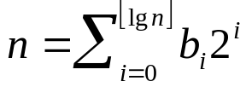
Properties of Binomial Heap
Property 2 above implies that an n-node binomial heap H consists of at most binomial trees.
Proof: the binary representation of n has bits, say , so that . Since each binomial tree contains an exact power of 2 of nodes, the only way for that three to occur is if the corresponding bit in the binary representation of n is set.
The next slide examines the representation of Binomial Heaps in terms of implementable data structures.

Slide 28
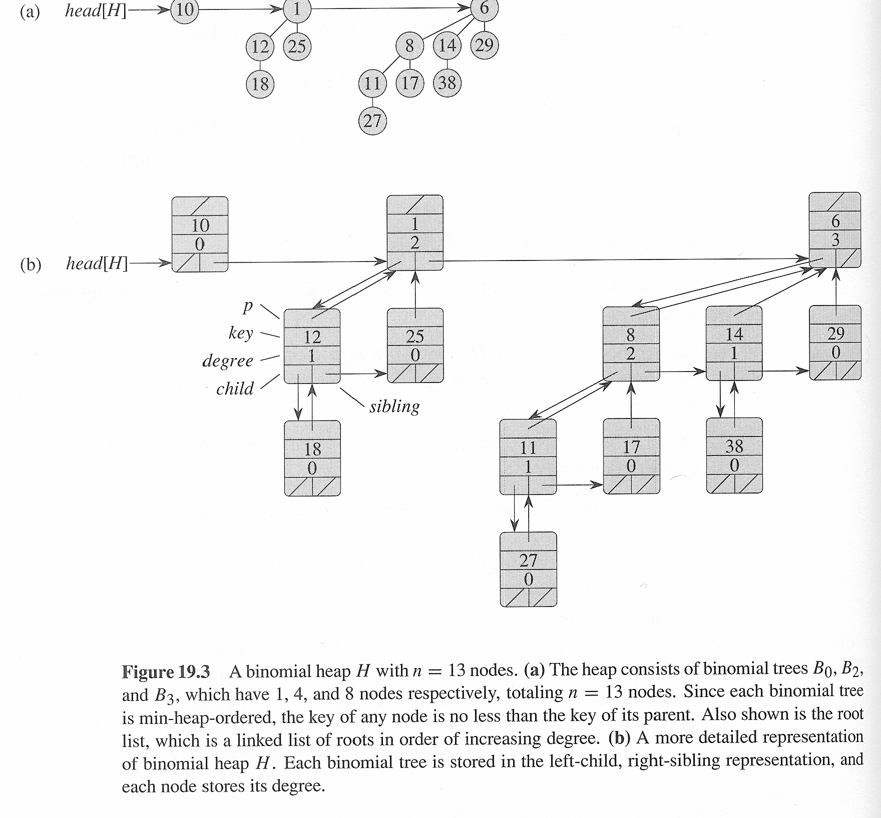
Representation of Binomial Heap

Slide 29
Binomial Heap: Properties
Properties of N-node binomial heap.
  Min key contained in root of B₀, B₁, . . . , B_{k}.
  Contains binomial tree B_{i} iff b_{i} = 1 where b_{n}⋅ b₂b₁b₀ is binary representation of N.
  At most ⎣log₂ N⎦ + 1 binomial trees.
  Height ≤ ⎣log₂ N⎦.
6
3
18
8
29
10
44
37
30
23
22
48
31
17
N = 19
# trees = 3
height = 4
binary = 10011
45
32
24
50
55
B₄
B₁
B₀

Slide 30
Binomial Heap Operation
Creating a new binomial heap
Finding the minimum key
Union
Insert
Extracting the node with minimum key
Decreasing a key
Deleting a key

Slide 31
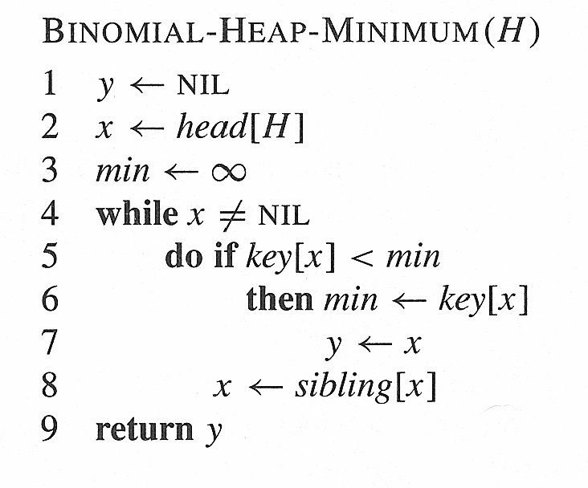

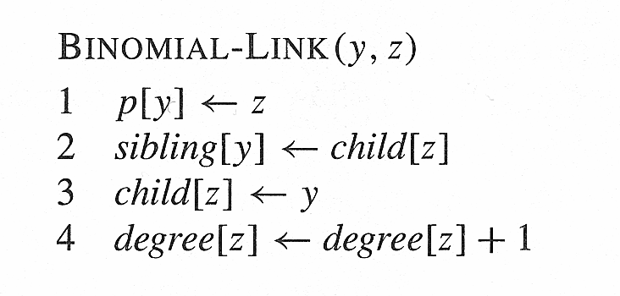
Binomial heap - Minimum
Binomial Heap-Minimum
The minimum value must reside at the root of a binomial tree. Since there are such trees at most, the running time of the algorithm is O(lg n).
Binomial-Link
Links two B_{k-1} trees (roots: y and z) into a B_{k} tree. Makes node y the new head of the linked list of node z’s children. Time: O(1).

Slide 32
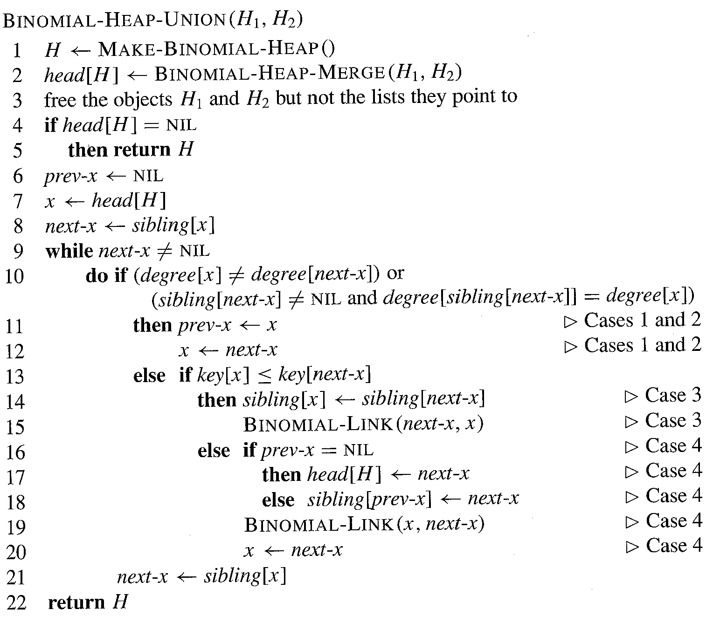
Binomial Heap - Union

Slide 33
Binomial Heap - Union
The Binomial-Heap-Merge in line 2 is a simple merge of the two lists of binomial trees in non-decreasing order of size. You may or may not wish to bother using key order for trees of the same size.
1. As long as two successive trees have different size, keep moving.
2. If two successive trees have the same size:
2a: if the third tree has different size, then just link them
2b: if the third has the same size (one from a just finished link and the other two from the merge) then skip the first and link the last two.
3. Keep doing this until done.

Slide 34
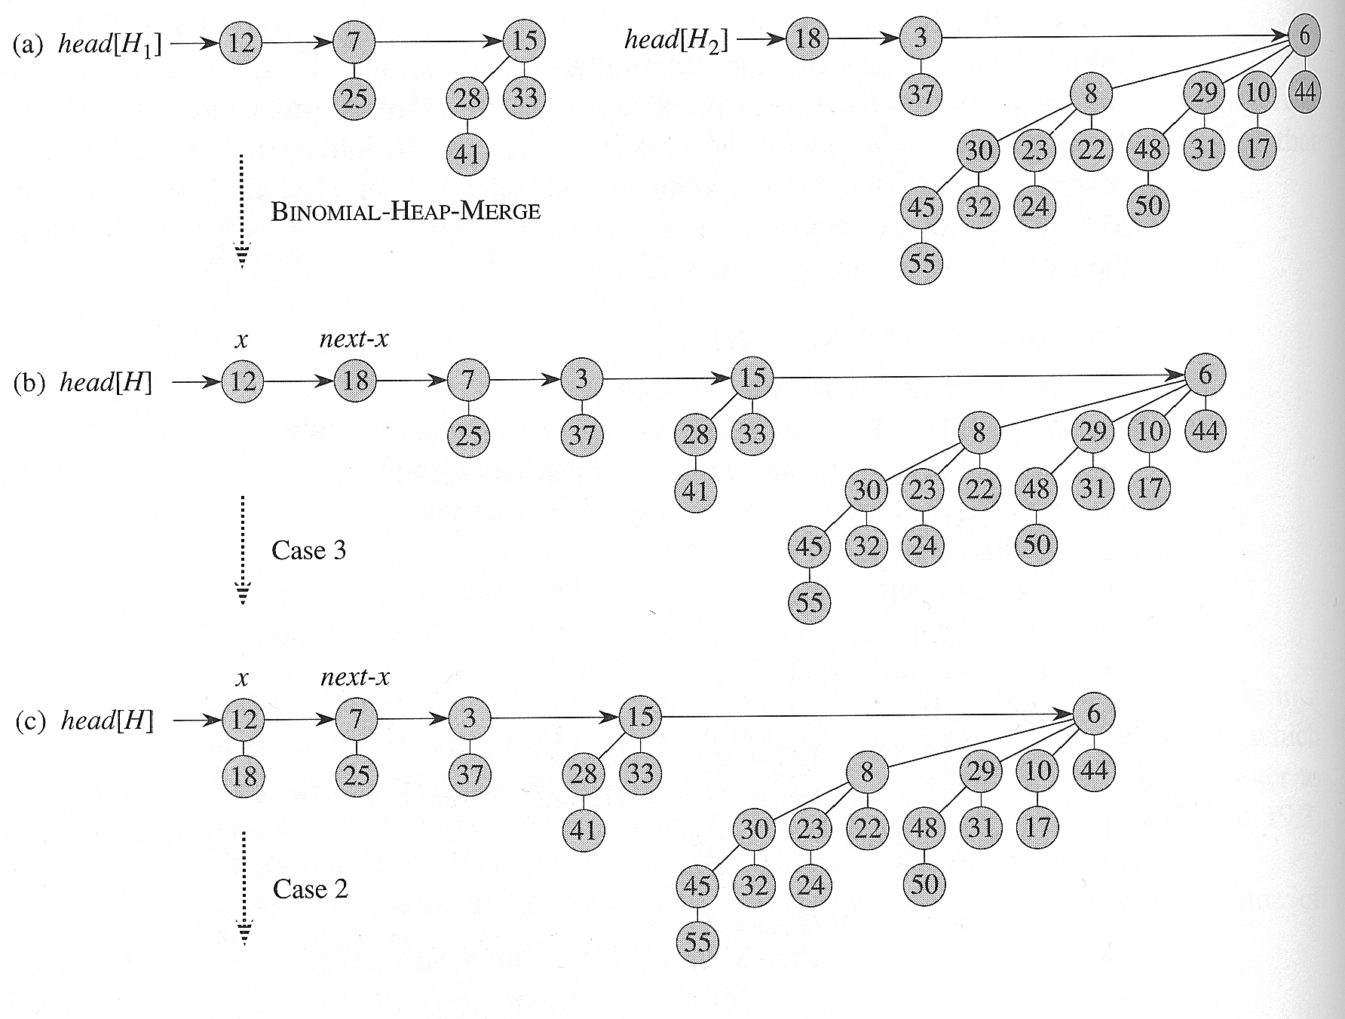
Binomial Heap - Union

Slide 35
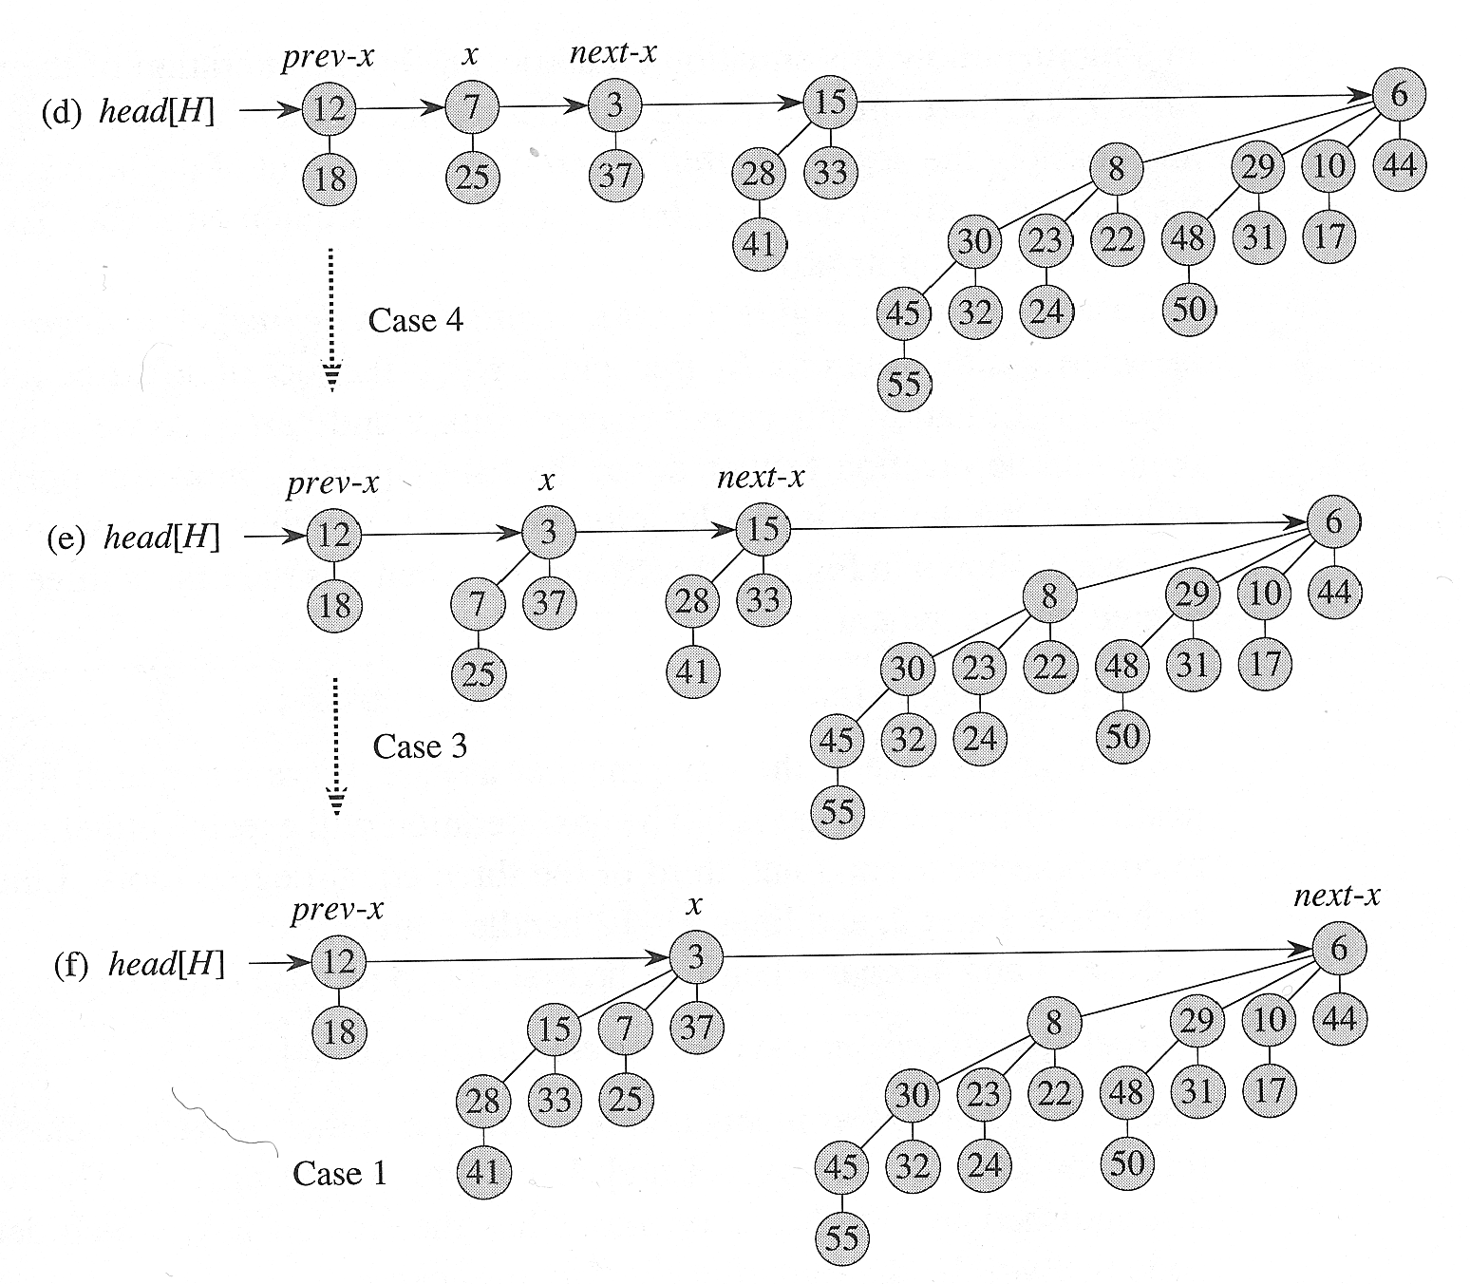
Binomial Heap - Union

Slide 36
Binomial Heap: Union
Create heap H that is union of heaps H' and H''.
  Analogous to binary addition.
Running time. O(log N)
  Proportional to number of trees in root lists ≤ 2( ⎣log₂ N⎦ + 1).
1
1
1
1
0
0
1
1
19 + 7 = 26
+
0
0
1
1
1
1
1
0
1
0

Slide 37
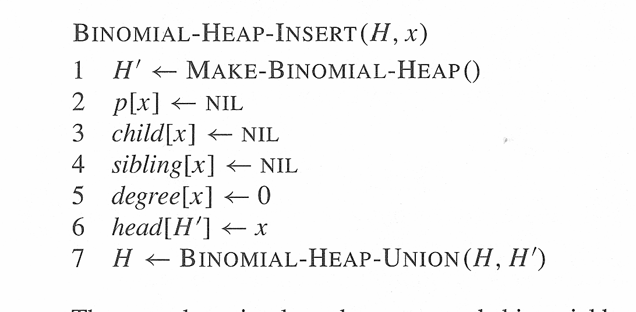
Binomial Heap - Insertion
The cost of insertion is O(1) from Make-Binomial-Heap and the assignments 2-6, plus O(lg n) from line 7.
Total: O(lg n)

Slide 38
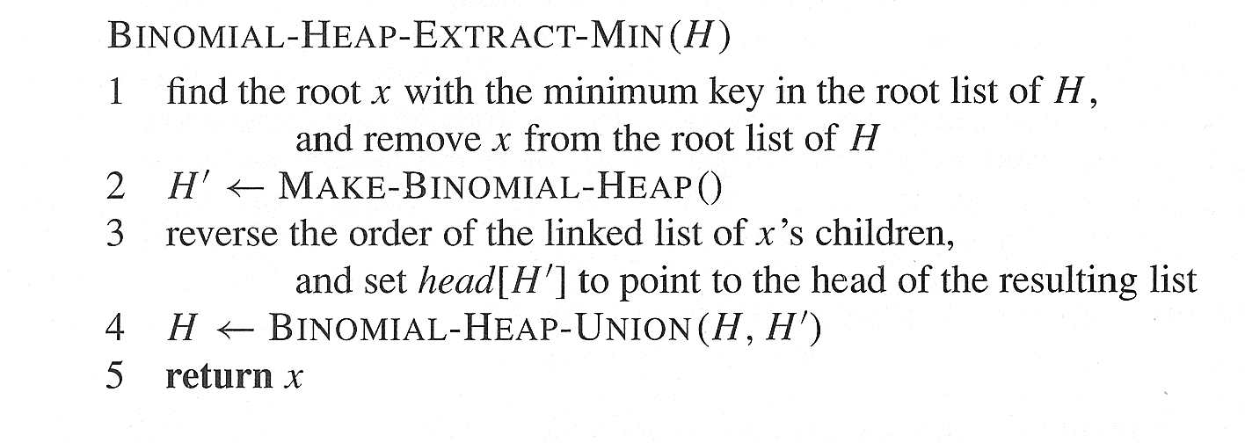
Binomial Heap – Extract Min
L1: O(lg n)
L2: O(1)
L3: O(lg n)
L4: O(lg n)
TOTAL: O(lg n)

Slide 39
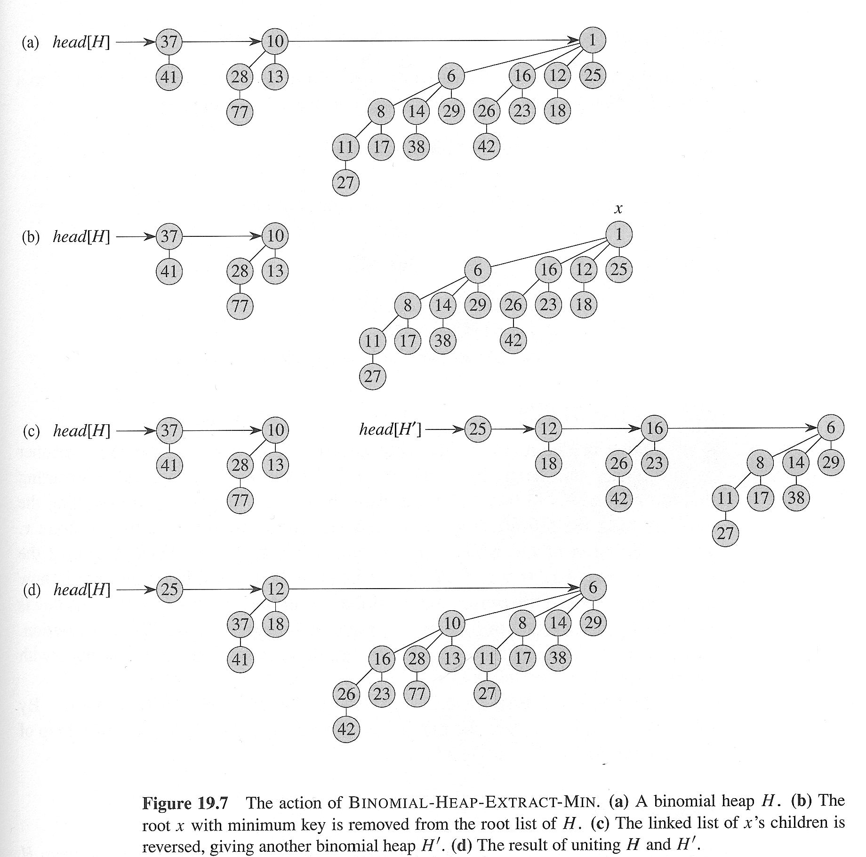
Binomial Heap: Extract Min

Slide 40
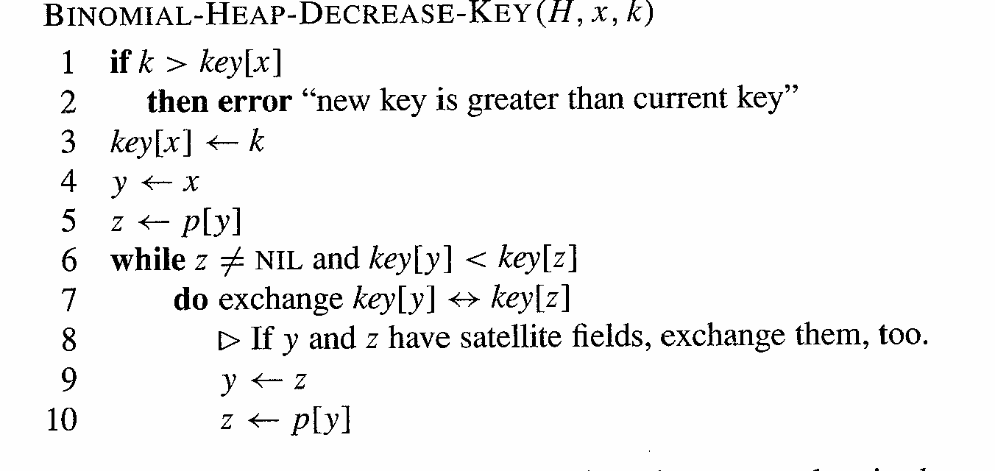
Binomial Heap: Decrease Key
Lines 6-10 can be repeated O(lg n) times. Each line in 1-5 is O(1), as well as each individual line in 6-10.
Total: O(lg n)

Slide 41
Binomial Heap: Decrease Key
Decrease key of node x in binomial heap H.
  Suppose x is in binomial tree B_{k}.
  Bubble node x up the tree if x is too small.
Running time. O(log N)
  Proportional to depth of node x ≤ ⎣log₂ N⎦ .
3
6
18
depth = 3
8
29
10
44
37
30
23
22
48
31
17
H
x
32
24
50
55
Notes:
B_{k} has height k and 2^{k} nodes

Slide 42
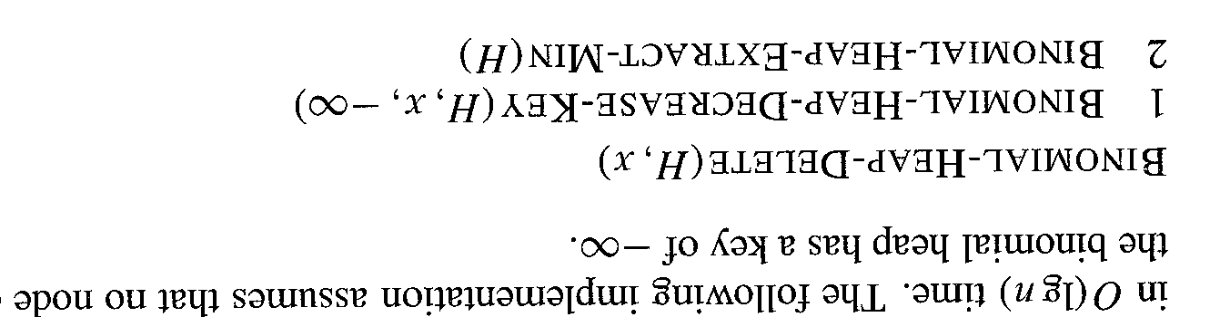
Binomial Heap: Deletion
Deletion is
L1: O(lg n)
L2: O(lg n)
Total: O(lg n)

Slide 43
Binomial Heap: Delete
Delete node x in binomial heap H.
  Decrease key of x to -∞.
  Delete min.
Running time. O(log N)

Slide 44
Priority Queues
Heaps
Operation
Linked List
Binary
Binomial
Fibonacci *
Relaxed
make-heap
1
1
1
1
1
insert
1
log N
log N
1
1
find-min
N
1
log N
1
1
delete-min
N
log N
log N
log N
log N
union
1
N
log N
1
1
decrease-key
1
log N
log N
1
1
delete
N
log N
log N
log N
log N
is-empty
1
1
1
1
1
just did this
Notes:
What about search? Idea 1 = use a hash table to keep track of item's position in the heap. Idea 2 = use a (balanced) search tree.

